Slide 1
PHP Forms Processing
Presented by Ulvi Bajarani, SID 20539914

Slide 2
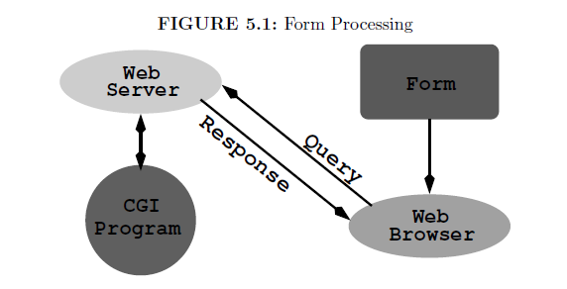

Slide 3
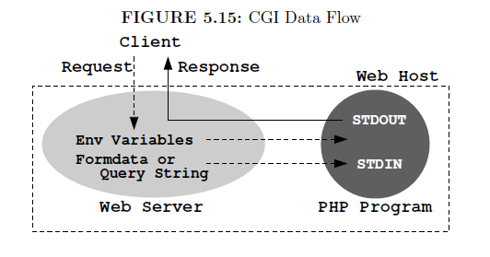

Slide 4
HTML Forms
Handled by <form></form> tags.
Might have various input control element types.
Might have either get or post methods.
Might have 3 types of encoding (only in the post method).
Might have user defined labels, which is important to define inputs.
Might have own attributes, event attributes and global attributes.

Slide 5
HTML Forms
Might contain one or more of the following form elements:
<input>
<textarea>
<button>
<select>
<option>
<optgroup>
<fieldset>
<label>
<output>
<datalist>

Slide 6
HTML <form> attributes (value in the parentheses)
accept-charset (character_set) – Specifies the type of the character encoding to be used for the form submission. Common values are UTF-8 and ISO-8859-1.
action (URL) – Specifies the place where the form is sent by the form submission.

Slide 7
HTML <form> attributes (value in the parentheses) [continued]
autocomplete (on or off) – Specifies if the form could have autocomplete on or off.
enctype (application/x-www-form-urlencoded or multipart/form-data or text/plain) – Specifies the place where the form is sent by the form submission.

Slide 8
HTML <form> attributes (value in the parentheses) [continued]
method (get or post) – Specifies the HTTP method when sending the data in forms.
rel (external or help or license or next or nofollow or noopener or noreferrer or opener or prev or search) – Specifies the relationship between a linked resource and the current document.

Slide 9
enctype attribute values
application/x-www-form-urlencoded Default. All characters are encoded before sent (spaces are converted to "+" symbols, and special characters are converted to ASCII HEX values)
multipart/form-data No characters are encoded. This value is required when you are using forms that have a file upload control.
text/plain Spaces are converted to "+" symbols, but no special characters are encoded.

Slide 10
The get method
Appends form-data into the URL in name/value pairs: URL?name=value&name=value
The length of a URL is limited (about 3000 characters)
Never use GET to send sensitive data! (will be visible in the URL)
Useful for form submissions where a user wants to bookmark the result, because might be cached.
GET is better for non-secure data, like query strings in Google.

Slide 11
The post method
Appends form-data inside the body of the HTTP request (data is not shown in URL)
Has no size limitations
Form submissions with POST cannot be bookmarked
Mostly used to send the sensitive data (password, etc.)

Slide 12
HTML form elements

Slide 13
<label>

Slide 14
<label>
In the proper usage, beneficial
for screen reader users;
for users who have difficulty clicking on very small regions (such as checkboxes): because when a user clicks the text within the <label> element, it toggles the input (this increases the hit area).

Slide 15
<label>
Defines the label for the next tags:
<input type="checkbox">
<input type="color">
<input type="date">
<input type="datetime-local">
<input type="email">
<input type="file">
<input type="month">
<input type="number">

Slide 16
<label> (continued)
Defines the label for the next tags:
<input type="password">
<input type="radio">
<input type="range">
<input type="search">
<input type="tel">
<input type="text">
<input type="time">
<input type="url">
<input type="week">

Slide 17
<label> (continued)
Defines the label for the next tags:
<meter>
<progress>
<select>
<textarea>

Slide 18
<label> (continued)
Have next attributes (value in the parentheses):
for (element_id) – Specifies the id of the form where the label is bounded. Must be equal to the id of the related element. Also, the element might also be bounded by placing inside the <label></label>.
form (form_id) – Specifies the form where the label is bounded.

Slide 19
<input>

Slide 20
Input control types: text
<!DOCTYPE html>
<html>
<body>
<form>
<label for="username">Username: </label>
<input type="text" id="username" name="username">
</form>
<br>
<form>
<label>Password:
<input type="text" id="password" name="password">
</label>
</form>
</body>
</html>

Slide 21
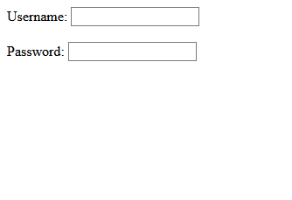

Slide 22
Input control types: submit
<!DOCTYPE html>
<html>
<body>
<form action="indexCheckbox.html">
<label for="fname">First name: </label>
<input type="text" id="fname" name="fname"><br><br>
<label for="lname">Last name: </label>
<input type="text" id="lname" name="lname"><br><br>
<input type="submit" value="Submit">
</form>
</body>
</html>

Slide 23

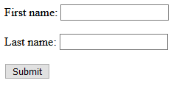

Slide 24
Input control types: button
<!DOCTYPE html>
<html>
<body>
<form>
<input type="button" value="Click me!">
</form>
</body>
</html>

Slide 25


Slide 26
Input control types: checkbox
<!DOCTYPE html>
<html>
<body>
<form>
<input type="checkbox" id="vehicle1" name="vehicle1" value="Bike">
<label for="vehicle1">a Bike</label><br>
<input type="checkbox" id="vehicle2" name="vehicle2" value="Car">
<label for="vehicle2">a Car</label><br>
<input type="checkbox" id="vehicle3" name="vehicle3" value="Boat">
<label for="vehicle3">a Boat</label><br>
</form>
</body>
</html>

Slide 27


Slide 28
Input control types: color
<!DOCTYPE html>
<html>
<body>
<form>
<label for="favcolor">Select your favorite color:</label>
<input type="color" id="favcolor" name="favcolor" value="#ff0000">
</form>
</body>
</html>

Slide 29

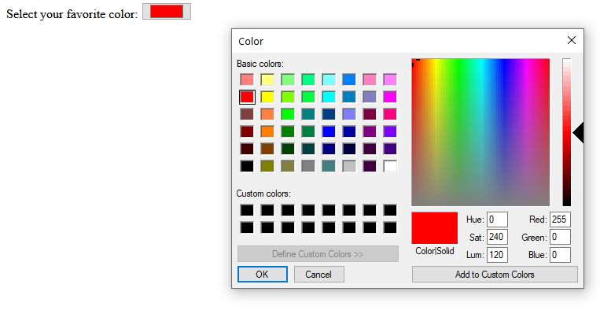

Slide 30
Input control types: date
<!DOCTYPE html>
<html>
<body>
<form>
<label for="birthday">Birthday:</label>
<input type="date" id="birthday" name="birthday">
</form>
</body>
</html>

Slide 31

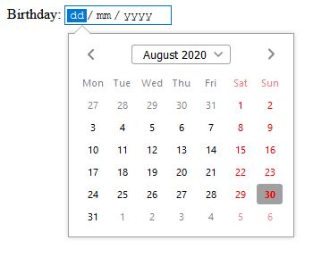

Slide 32
Input control types: datetime-local (supported in some browsers)
<!DOCTYPE html>
<html>
<body>
<form>
<label for="birthdaytime">Birthday (date and time):</label>
<input type="datetime-local" id="birthdaytime" name="birthdaytime">
</form>
</body>
</html>

Slide 33


Slide 34
Input control types: email
<!DOCTYPE html>
<html>
<body>
<form>
<label for="email">Enter your email:</label>
<input type="email" id="email" name="email">
</form>
</body>
</html>

Slide 35

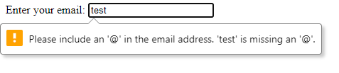

Slide 36
Input control types: file
It is possible to define the type of the file by accept attribute, which takes one of these values (possible for other media types):
audio/*
video/*
image/*
Do not use this attribute as a validation tool. File uploads should be validated on the server.

Slide 37
Input control types: file
<!DOCTYPE html>
<html>
<body>
<form>
<label for="myfile">Select a file:</label>
<input type="file" id="myfile" name="myfile">
</form>
</body>
</html>

Slide 38

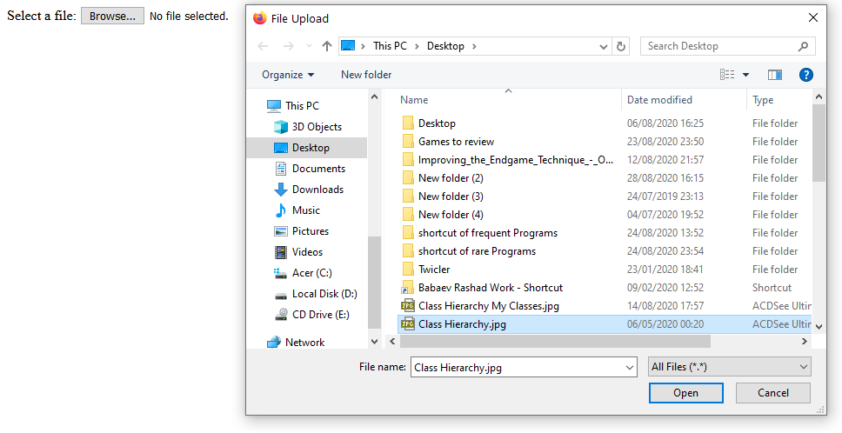


Slide 39
Input control types: hidden (used for developers to know the column to update in the database)
<!DOCTYPE html>
<html>
<body>
<form>
<input type="hidden" id="custId" name="custId" value="3487">
</form>
</body>
</html>

Slide 40
Input control types: image
Might contain alt attribute for alternative text.
Might contain src attribute for the URL of the image.
As the type=”submit” value, might has own encoding values by formenctype attribute.
As the type=”submit” value, might has own method by formmethod attribute.
As the type=”submit” , might has own action by formaction attribute.
As the type=”submit” , might has own target by formtarget attribute.
Might define the image width and height pixels by width and height attributes, respectively.

Slide 41
Input control types: image
<!DOCTYPE html>
<html>
<body>
<form action="indexCheckbox.html">
<label for="fname">First name: </label>
<input type="text" id="fname" name="fname"><br><br>
<label for="lname">Last name: </label>
<input type="text" id="lname" name="lname"><br><br>
<input type="image" src="test.jpg" alt="Submit" width="48" height="48">
</form>
</body>
</html>

Slide 42
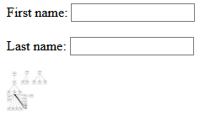

Slide 43
Input control types: month
<!DOCTYPE html>
<html>
<body>
<form>
<label for="bdaymonth">Birthday (month and year):</label>
<input type="month" id="bdaymonth" name="bdaymonth">
</form>
</body>
</html>

Slide 44

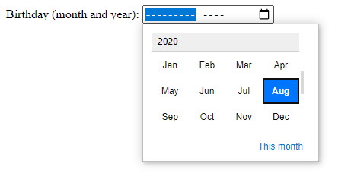

Slide 45
Input control types: number
It is possible to set restrictions on what numbers are accepted with the attributes below:
max - specifies the maximum value allowed;
min - specifies the minimum value allowed;
step - specifies the legal number intervals;
value - Specifies the default value.

Slide 46
Input control types: number
<!DOCTYPE html>
<html>
<body>
<form action="indexCheckbox.html">
<label for="quantity">Quantity (between 1 and 5):</label>
<input type="number" id="quantity" name="quantity" min="1" max="5">
</form>
</body>
</html>

Slide 47



Slide 48
Input control types: password (should be used over HTTPS)
<!DOCTYPE html>
<html>
<body>
<form>
<label for="pwd">Password:</label>
<input type="password" id="pwd" name="pwd">
</form>
</body>
</html>

Slide 49



Slide 50
Input control types: radio
As the type=”checkbox” value, the element might be defined as pre-selected by checked attribute (doesn’t require any values)

Slide 51
Input control types: radio
<!DOCTYPE html>
<html>
<body>
<form>
<input type="radio" id="male" name="gender" value="male">
<label for="male">Male</label><br>
<input type="radio" id="female" name="gender" value="female">
<label for="female">Female</label><br>
<input type="radio" id="other" name="gender" value="other">
<label for="other">Other</label>
</form>
</body>
</html>

Slide 52




Slide 53
Input control types: range
Default range is 0 to 100. However, it is possible to set restrictions on what numbers are accepted with the attributes below:
max - specifies the maximum value allowed;
min - specifies the minimum value allowed;
step - specifies the legal number intervals;
value - Specifies the default value.

Slide 54
Input control types: range
<!DOCTYPE html>
<html>
<body>
<form>
<label for="points">Points (between 0 and 10):</label>
<input type="range" id="points" name="points" min="0" max="10">
</form>
</body>
</html>

Slide 55




Slide 56
Input control types: reset
<!DOCTYPE html>
<html>
<body>
<form>
<label for="pin">Enter a PIN:</label>
<input type="text" id="pin" name="pin" maxlength="4"><br><br>
<input type="reset" value="Reset">
</form>
</body>
</html>

Slide 57




Slide 58
Input control types: search (must have the name [commonly “q”] )
<!DOCTYPE html>
<html>
<body>
<form>
<label for="gsearch">Search Google:</label>
<input type="search" id="gsearch" name="gsearch">
</form>
</body>
</html>

Slide 59


Slide 60
Input control types: tel
<!DOCTYPE html>
<html>
<body>
<form>
<label for="phone">Enter your phone number:</label>
<input type="tel" id="phone" name="phone" pattern="[0-9]{3}-[0-9]{2}-[0-9]{3}">
</form>
</body>
</html>

Slide 61



Slide 62
Input control types: time
<!DOCTYPE html>
<html>
<body>
<form>
<label for="appt">Select a time:</label>
<input type="time" id="appt" name="appt">
</form>
</body>
</html>

Slide 63



Slide 64
Input control types: url
<!DOCTYPE html>
<html>
<body>
<form>
<label for="homepage">Add your homepage:</label>
<input type="url" id="homepage" name="homepage"><br><br>
</form>
</body>
</html>

Slide 65

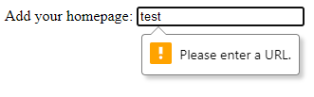

Slide 66
Input control types: week (supported in some browsers)
<!DOCTYPE html>
<html>
<body>
<form>
<label for="week">Select a week:</label>
<input type="week" id="week" name="week">
</form>
</body>
</html>

Slide 67

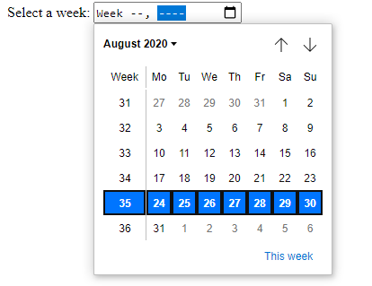

Slide 68
Other <input> attributes (values are in the parentheses)
autocomplete ( on or off ) Specifies whether an <input> element should have autocomplete enabled
autofocus Specifies that an <input> element should automatically get focus when the page loads
dirname ( inputname.dir ) Specifies that the text direction will be submitted
disabled Specifies that an <input> element should be disabled
form ( form_id ) Specifies the form the <input> element belongs to
formnovalidate Defines that form elements should not be validated when submitted
list ( datalist_id ) Refers to a <datalist> element that contains pre-defined options for an <input> element

Slide 69
Other <input> attributes (values are in the parentheses)
maxlength ( number ) Specifies the maximum number of characters allowed in an <input> element
minlength ( number ) Specifies the minimum number of characters required in an <input> element
multiple Specifies that a user can enter more than one value in an <input> element
name ( text ) Specifies the name of an <input> element
pattern ( regexp ) Specifies a regular expression that an <input> element's value is checked against
placeholder ( text ) Specifies a short hint that describes the expected value of an <input> element
readonly Specifies that an input field is read-only
required Specifies that an input field must be filled out before submitting the form
size ( number ) Specifies the width, in characters, of an <input> element
value ( text ) Specifies the value of an <input> element

Slide 70
<button>

Slide 71
<button> tag
Unlike <input type=”button”>, might accept the text and other tags (<i>, <strong>, <img> etc.).
Has three values for the type attribute: button, submit, reset.

Slide 72
<button> tag
<!DOCTYPE html>
<html>
<body>
<form>
<button type="button"><i>Click Me!</i></button>
</form>
</body>
</html>

Slide 73


Slide 74
Other <button> attributes (values in the parentheses)
autofocus Specifies that a button should automatically get focus when the page loads
disabled Specifies that a button should be disabled
form ( form_id ) Specifies which form the button belongs to
formaction ( URL ) Specifies where to send the form-data when a form is submitted. Only for type="submit"
formenctype ( application/x-www-form-urlencoded or multipart/form-data or text/plain ) Specifies how form-data should be encoded before sending it to a server. Only for type="submit"

Slide 75
Other <button> attributes (values in the parentheses) (continued)
formmethod ( get or post ) Specifies how to send the form-data (which HTTP method to use). Only for type="submit"
formnovalidate Specifies that the form-data should not be validated on submission. Only for type="submit"
formtarget ( _blank or _self or _parent or _top or framename ) Specifies where to display the response after submitting the form. Only for type="submit"
name ( name ) Specifies a name for the button
type ( button or reset or submit ) Specifies the type of button
value ( text ) Specifies an initial value for the button

Slide 76
<textarea>

Slide 77
<textarea> tag
Creates the multi-line text area.
Might also be adjusted after being created.
The number of visible rows in the area might be adjusted by rows attribute.
The number of visible width in the area might be adjusted by cols attribute.

Slide 78
<textarea> tag
<!DOCTYPE html>
<html>
<body>
<h1>The textarea element</h1>
<form>
<textarea id="presentation" name="presentation" rows="4" cols="50">
There is a plain text. You can remove it and write something.</textarea>
</form>
</body>
</html>

Slide 79
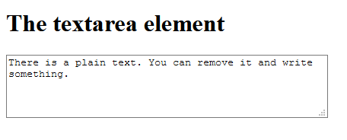
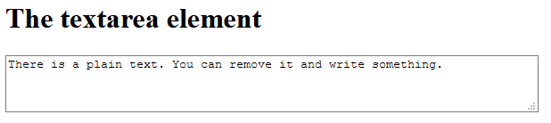

Slide 80
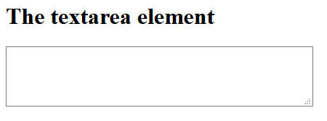
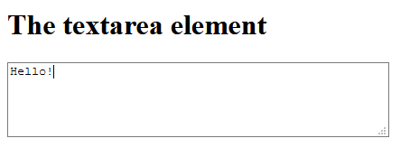

Slide 81
Other <textarea> attributes (values in the parentheses)
autofocus Specifies that a text area should automatically get focus when the page loads.
dirname ( textareaname.dir ) Specifies that the text direction of the textarea will be submitted.
disabled Specifies that a text area should be disabled.
form ( form_id ) Specifies which form the text area belongs to.

Slide 82
Other <textarea> attributes (values in the parentheses) (continued)
maxlength ( number ) Specifies the maximum number of characters allowed in the text area
name ( text ) Specifies a name for a text area
placeholder ( text ) Specifies a short hint that describes the expected value of a text area
readonly Specifies that a text area should be read-only
required Specifies that a text area is required/must be filled out
wrap ( hard or soft ) Specifies how the text in a text area is to be wrapped when submitted in a form

Slide 83
<option>

Slide 84
<option> Tag
Defines the options in the list.
Usually goes inside <select>, <optgroup>, <datalist> tags.
Should have value attribute if it is used lonely.

Slide 85
<option> attributes (values in the parentheses)
disabled Specifies that an option should be disabled
label ( text ) Specifies a shorter label for an option
selected Specifies that an option should be pre-selected when the page loads
value ( text ) Specifies the value to be sent to a server

Slide 86
<select>

Slide 87
<select> tag
Creates a drop-down list.
Often used to collect data.
To submit the data, it is important to reference the form data by name attribute.
To associate with the label, id attribute is required.

Slide 88
<select> tag
<!DOCTYPE html>
<html>
<body>
<label for="cars">Choose a car:</label>
<select id="cars">
<option value="volvo">Volvo</option>
<option value="saab">Saab</option>
<option value="opel">Opel</option>
<option value="audi">Audi</option>
</select>
</body>
</html>

Slide 89

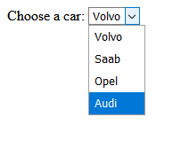
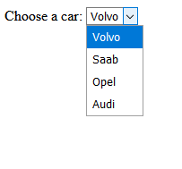


Slide 90
Other <select> attributes (values in the parentheses)
autofocus Specifies that the drop-down list should automatically get focus when the page loads
disabled Specifies that a drop-down list should be disabled
form ( form_id ) Defines which form the drop-down list belongs to
multiple Specifies that multiple options can be selected at once. To select it, Ctrl+Mouseclick might be used.
name ( name ) Defines a name for the drop-down list
required Specifies that the user is required to select a value before submitting the form
size ( number ) Defines the number of visible options in a drop-down list

Slide 91
<optgroup>

Slide 92
<optgroup> tag
Is used to group the tag-related options in the <select> tag.
Makes the distinguishing the options easier.

Slide 93
<optgroup> tag
<!DOCTYPE html>
<html>
<body>
<label for="cars">Choose a car:</label>
<select name="cars" id="cars">
<optgroup label="Swedish Cars">
<option value="volvo">Volvo</option>
<option value="saab">Saab</option>
</optgroup>
<optgroup label="German Cars">
<option value="mercedes">Mercedes</option>
<option value="audi">Audi</option>
</optgroup>
</select>
</body>
</html>

Slide 94

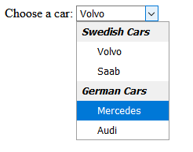
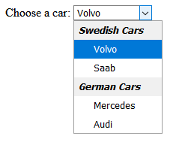


Slide 95
<optgroup> attributes (values in the parentheses)
disabled Specifies that an option-group should be disabled
label ( text ) Specifies a label for an option-group

Slide 96
<fieldset>

Slide 97
<fieldset> tag
The <fieldset> tag is used to group the elements in the <form>
The <fieldset> tag draws the box around the tag.
The <legend> tag is used to define a caption for the <fieldset> element.

Slide 98
<fieldset> tag
<!DOCTYPE html>
<html>
<body>
<form>
<fieldset>
<legend>Personalia:</legend>
<label for="fname">First name:</label>
<input type="text" id="fname" name="fname"><br><br>
<label for="lname">Last name:</label>
<input type="text" id="lname" name="lname"><br><br>
<label for="email">Email:</label>
<input type="email" id="email" name="email"><br><br>
<label for="birthday">Birthday:</label>
<input type="date" id="birthday" name="birthday"><br><br>
</fieldset>
</form>
</select>
</body>
</html>

Slide 99
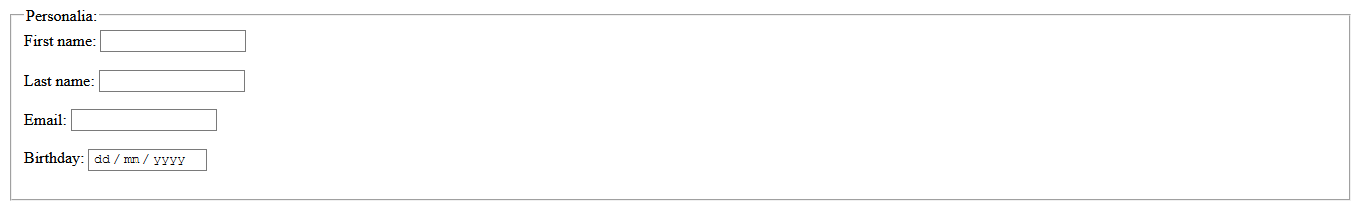

Slide 100
<fieldset> attributes (values in the parentheses)
disabled Specifies that a group of related form elements should be disabled
form ( form_id ) Specifies which form the fieldset belongs to
name ( text ) Specifies a name for the fieldset

Slide 101
<datalist>

Slide 102
<datalist> tag
Specifies a list of pre-defined options for an <input> element. It is done by "autocomplete" feature for <input> elements. Users will see a drop-down list of pre-defined options as they input data.
The <datalist> element's id attribute must be equal to the <input> element's list attribute (this binds them together).

Slide 103
<datalist> tag
<!DOCTYPE html>
<html>
<body>
<label for="browser">Choose your browser from the list:</label>
<input list="browsers" name="browser" id="browser">
<datalist id="browsers">
<option value="Edge">
<option value="Firefox">
<option value="Chrome">
<option value="Opera">
<option value="Safari">
</datalist>
</select>
</body>
</html>

Slide 104

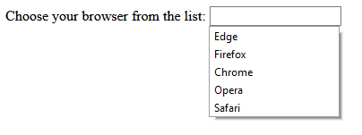
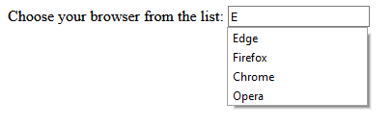

Slide 105
<output>

Slide 106
<output> tag
Performs a calculation and describes the result.

Slide 107
<output> tag
<!DOCTYPE html>
<html>
<body>
<form oninput="x.value=parseInt(a.value)+parseInt(b.value)">
<input type="range" id="a" value="50">
+<input type="number" id="b" value="25">
=<output name="x" for="a b"></output>
</form>
</select>
</body>
</html>

Slide 108



Slide 109
<output> tag attributes
for ( element_id ) Specifies the relationship between the result of the calculation, and the elements used in the calculation
form ( form_id ) Specifies which form the output element belongs to
name ( name ) Specifies a name for the output element

Slide 110
PHP

Slide 111
PHP
High-level, interpreter-based programming language.
The files for PHP code has .php suffix. Some servers might execute the PHP code from .html files.
Free, widely used, and open source.
The scripts are executed in the server.

Slide 112
PHP code structure
<?php
/* The commands are placed between brackets.
This is a multi-line comment */
// This is a single-line comment
# This is also a single-line comment
?>

Slide 113
PHP output
The display is done by echo command (the alternative is print). For example,
<?php
echo "<p>Hello World!</p><br>";
?>
The statement is terminated by semicolon ;
While the keywords are not case sensitive, the variables are case sensitive.

Slide 114


Slide 115
PHP variables
The variables starting with $ sign. For example, variable test is $test
All variables have a dynamic data type. It means that PHP itself defines the type of data (String, Integer, Float/Double, Boolean, Array, Object, NULL, Resource)
The variables can be used inside and outside of string in echo
<?php
$txt = "Hello world!";
$x = 5;
$y = 10.5;
echo $txt;
echo "The result of $x + $y is" . $coLOR . "<br>";
?>

Slide 116
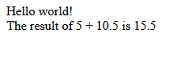

Slide 117
PHP scopes
There are 3 scopes of variables:
Local
Global
Static
If the variable defined inside the function, its scope is local. Local variables can be accessed only inside of the function.
If the variable defined outside the function, its scope is global. The global variables can be accessed only outside of the function. If such an access should be done, global keyword should be used. All global variables are stored in an array called $GLOBALS[index], where index is the name of the variable.
Static variables are local variables kept after the function execution. static word should be added before such a variable.

Slide 118
PHP global scope
<?php
$x = 5; // global scope
function myTest() {
// using x inside this function will generate an error
echo "<p>Variable x inside function is: $x</p>";
}
myTest();
echo "<p>Variable x outside function is: $x</p>";
?>

Slide 119


Slide 120
PHP global scope (global keyword)
<?php
$x = 5;
$y = 10;
function myTest() {
global $x, $y;
$y = $x + $y;
}
myTest();
echo $y; // outputs 15
?>

Slide 121


Slide 122
PHP local scope
<?php
function myTest() {
$x = 5; // local scope
echo "<p>Variable x inside function is: $x</p>";
}
myTest();
// using x outside the function will generate an error
echo "<p>Variable x outside function is: $x</p>";
?>

Slide 123
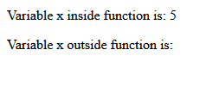

Slide 124
PHP static scope
<?php
function myTest() {
static $x = 0;
echo $x;
$x++;
}
myTest();
echo "<br>";
myTest();
echo "<br>";
myTest();
?>

Slide 125


Slide 126
PHP Operators
Operators are used to perform operations on variables and values.
PHP divides the operators in the following groups:
Arithmetic operators
Assignment operators
Comparison operators
Increment/Decrement operators
Logical operators
String operators
Array operators
Conditional assignment operators

Slide 127
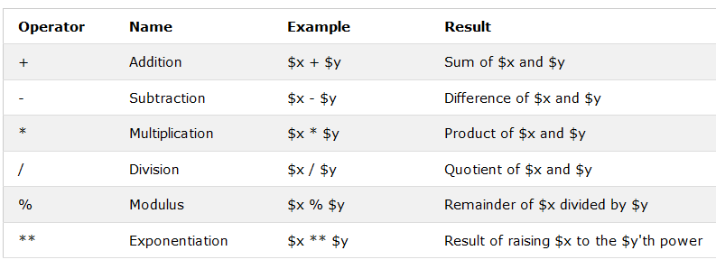
PHP Arithmetic Operators

Slide 128
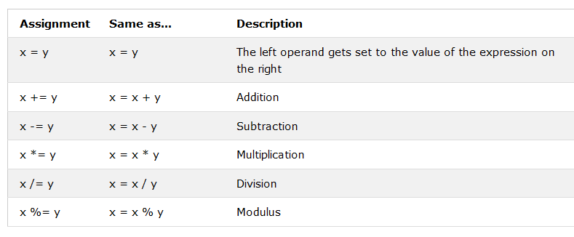
PHP Assignment Operators

Slide 129
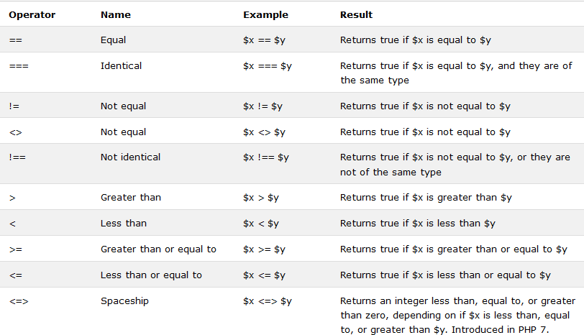
PHP Comparison Operators

Slide 130
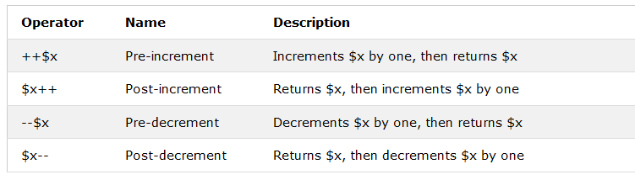
PHP Increment / Decrement Operators

Slide 131
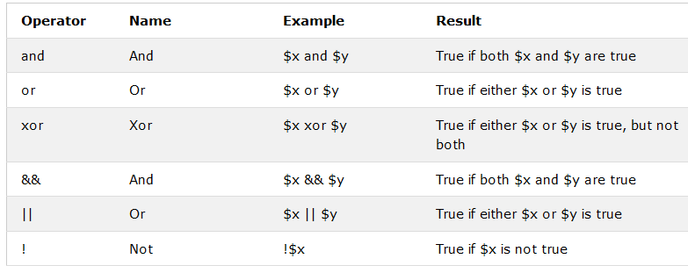
PHP Logical Operators

Slide 132
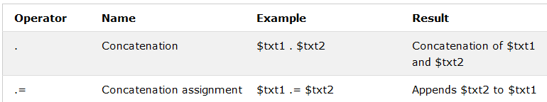
PHP String Operators

Slide 133
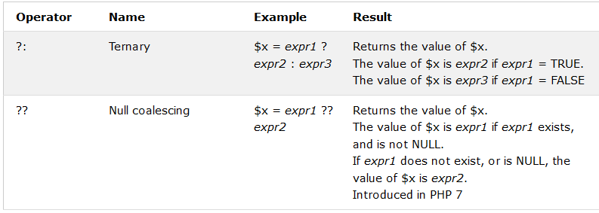
PHP Conditional Assignment Operators

Slide 134
PHP Conditional Statements
if statement – executes some code if a condition is true
if...else statement – executes some code if a condition is true and another code if that condition is false
if...elseif...else statement – executes different codes for more than two conditions.
switch statement – selects one of many blocks of code to be executed.

Slide 135
PHP if Statement
if (condition) {
code to be executed if condition is true;
}
For example,
<?php
$t = 5;
if ($t < 6) {
echo "$t is smaller than 6";
}
?>

Slide 136


Slide 137
PHP if...else Statement
if (condition) {
code to be executed if condition is true;
} else {
code to be executed if condition is false;
}
For example,
<?php
$t = 7;
if ($t < 6) {echo "$t is smaller than 6";}
else
{echo "$t is not smaller than 6";}
?>

Slide 138


Slide 139
PHP if...elseif...else Statement
if (condition) {
code to be executed if this condition is true;
} elseif (condition) {
code to be executed if first condition is false and this condition is true;
} else {
code to be executed if all conditions are false;
}
For example,
<?php
$t = 6;
if ($t < 6) {echo "$t is smaller than 6";}
elseif ($t === 6) {echo "t is equal to 6";}
else {echo "$t is not smaller than 6";}
?>

Slide 140


Slide 141
PHP switch Statements
switch (n) {
case label1:
code to be executed if n=label1;
break; /* if the break is not included, all cases till the first break/end is executed */
case label2:
code to be executed if n=label2;
break;
case label3:
code to be executed if n=label3;
break;
...
default:
code to be executed if n is different from all labels;
}

Slide 142
PHP switch Statements (continued)
<?php
$favcolor = "blue";
switch ($favcolor) {
case "red":
echo "Your favorite color is red!";
break;
case "blue":
echo "Your favorite color is blue!";
break;
case "green":
echo "Your favorite color is green!";
break;
default:
echo "Your favorite color is neither red, blue, nor green!";
}
?>

Slide 143


Slide 144
PHP Loops
Loops are used to execute the same block of code again and again, as long as a certain condition is true.
In PHP, we have the following loop types:
while – loops through a block of code as long as the specified condition is true
do...while – loops through a block of code once, and then repeats the loop as long as the specified condition is true
for – loops through a block of code a specified number of times
foreach – loops through a block of code for each element in an array

Slide 145
PHP while loops
while (condition is true) {
code to be executed;
}
For example,
<?php
$x = 1;
while($x <= 5) {
echo "The number is: $x <br>";
$x++;
}
?>

Slide 146
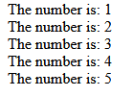

Slide 147
PHP do...while loops
do {
code to be executed;
} while (condition is true);
For example,
<?php
$x = 1;
do {
echo "The number is: $x <br>";
$x++;
} while ($x < 1);
?>

Slide 148


Slide 149
PHP for loops
for (init counter; test counter; increment counter) {
code to be executed for each iteration;
}
For example,
<?php
for ($x = 0; $x <= 10; $x++) {
echo "The number is: $x <br>";
}
?>

Slide 150
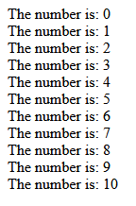

Slide 151
PHP foreach loops
foreach ($array as $value) {
code to be executed;
}
For example,
<?php
$colors = array("red", "green", "blue", "yellow");
foreach ($colors as $value) {
echo "$value <br>";
}
?>

Slide 152


Slide 153
break
To jump out of the loop. Also, could be used for jumping out of the switch, as it described before.
For example,
<?php
for ($x = 0; $x < 10; $x++) {
if ($x == 4) {
break;
}
echo "The number is: $x <br>";
}
?>

Slide 154


Slide 155
continue
To break one iteration (in the loop), if a specified condition occurs, and continues with the next iteration in the loop.
For example,
<?php
for ($x = 0; $x < 10; $x++) {
if ($x == 4) {
continue;
}
echo "The number is: $x <br>";
}
?>

Slide 156
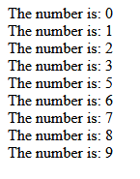

Slide 157
PHP functions
function nameOfTheFunction (variables)
{
/* Definition */
}
nameOfTheFunction (variableValues);

Slide 158
PHP functions (continue)
<?php
function writeMsg() {
echo "Hello world!<br>";
}
writeMsg(); // call the function
function Test($name, $surname) {
echo "Hello $name $surname!<br>";
}
Test("Ulvi", "Bajarani");
function TestDefaultValue($name="John", $surname="Doe") {
echo "Hello $name $surname!<br>";
}
TestDefaultValue("Ulvi", "Bajarani");
TestDefaultValue();
function TestAddition($a, $b) {
return $a + $b;
}
TestAddition(5, 10);
?>

Slide 159
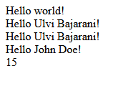

Slide 160
PHP Array
Created by array(values);
For example,
<?php
$cars = array("Volvo", "BMW", "Toyota");
echo "I like " . $cars[0] . ", " . $cars[1] . " and " . $cars[2] . ".";
?>

Slide 161


Slide 162
PHP super global variables
The super global variables allow the usage of HTTP requests:
$_POST – for post formdata
$_GET – for get formdata or query string.
$_REQUEST – for either get or post request data.
$_SERVER – for information related to the Web server, HTTP request headers, and the PHP script itself
$_ENV – for CGI defined variables and any form the shell used on particular operating systems
$_COOKIES – for stored cookies
$_SESSION – for session information

Slide 163
PHP Form Processing
Is done by $_GET["name"] and $_POST["name"] methods (same as HTML’s get and post). For details please go to the proper slide.

Slide 164
PHP Form Processing (continued)
<html>
<body>
<form action="" method="post">
Name: <input type="text" name="name"><br>E-mail: <input type="text" name="email"><br><input type="submit" name="SubmitButton">
</form>
<?php
if(isset($_POST['SubmitButton']))
{echo "Welcome: " . $_POST["name"] . "<br>" . "Your email address is: " . $_POST["email"] ;}
?>
</body>
</html>

Slide 165

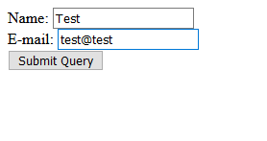
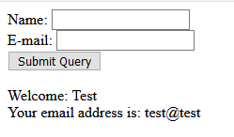

Slide 166
PHP Form Validation
$_SERVER["PHP_SELF"] is a super global variable returning the file name of the executing script. It submits the data in the same page instead of jumping to another page.
Can be used by hackers.
To avoid the interception by hackers:
Use htmlspecialchars() function for $_SERVER["PHP_SELF"]. The function converts all characters to HTML characters, which allows to avoid JavaScript code execution (Cross-site Scripting attacks)
Remove extra spaces/tabs by trim() function
Remove \ - Backslashes by stripslashes() function

Slide 167
PHP Form Validation (continued)
<!DOCTYPE HTML>
<html>
<head>
</head>
<body>
<?php
// define variables and set to empty values
$name = $email = $gender = $comment = $website = "";
if ($_SERVER["REQUEST_METHOD"] == "POST") {
$name = test_input($_POST["name"]);
$email = test_input($_POST["email"]);
$website = test_input($_POST["website"]);
$comment = test_input($_POST["comment"]);
$gender = test_input($_POST["gender"]);
}

Slide 168
PHP Form Validation (continued) the continue of the code
function test_input($data) {
$data = trim($data);
$data = stripslashes($data);
$data = htmlspecialchars($data);
return $data;
}
?>
<h2>PHP Form Validation Example</h2>

Slide 169
PHP Form Validation (continued) the continue of the code
<form method="post" action="<?php echo htmlspecialchars($_SERVER["PHP_SELF"]);?>">
Name: <input type="text" name="name">
<br><br>
E-mail: <input type="text" name="email">
<br><br>
Website: <input type="text" name="website">
<br><br>
Comment: <textarea name="comment" rows="5" cols="40"></textarea>
<br><br>
Gender:
<input type="radio" name="gender" value="female">Female
<input type="radio" name="gender" value="male">Male
<input type="radio" name="gender" value="other">Other
<br><br>
<input type="submit" name="submit" value="Submit">
</form>

Slide 170
PHP Form Validation (continued) the continue of the code
<?php
echo "<h2>Your Input:</h2>";
echo $name;
echo "<br>";
echo $email;
echo "<br>";
echo $website;
echo "<br>";
echo $comment;
echo "<br>";
echo $gender;
?>
</body>
</html>

Slide 171
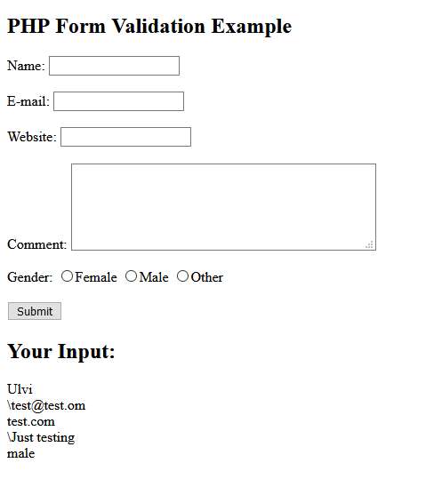
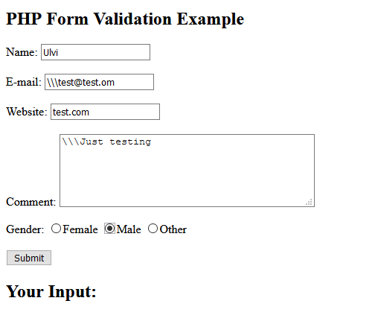
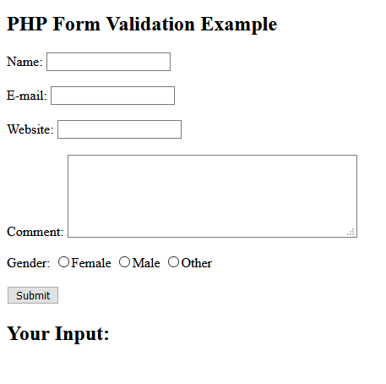

Slide 172
PHP Form Validation
To check if the variable is empty, we use empty() function.

Slide 173
PHP Form Validation (continued)
<!DOCTYPE HTML>
<html>
<head>
<style>
.error {color: #FF0000;}
</style>
</head>
<body>
<?php
// define variables and set to empty values
$nameErr = $emailErr = $genderErr = $websiteErr = "";
$name = $email = $gender = $comment = $website = "";

Slide 174
PHP Form Validation (continued) the continue of the code
if ($_SERVER["REQUEST_METHOD"] == "POST") {
if (empty($_POST["name"])) {$nameErr = "Name is required";} else {$name = test_input($_POST["name"]);}
if (empty($_POST["email"])) {$emailErr = "Email is required";} else {$email = test_input($_POST["email"]);}
if (empty($_POST["website"])) {$website = "";} else {$website = test_input($_POST["website"]);}
if (empty($_POST["comment"])) {$comment = "";} else {$comment = test_input($_POST["comment"]);}
if (empty($_POST["gender"])) {$genderErr = "Gender is required";} else {$gender = test_input($_POST["gender"]);}
}
?>

Slide 175
PHP Form Validation (continued) the continue of the code
<h2>PHP Form Validation Example</h2><p><span class="error">* required field</span></p><form method="post" action="<?php echo htmlspecialchars($_SERVER["PHP_SELF"]);?>">Name: <input type="text" name="name"><span class="error">* <?php echo $nameErr;?></span><br><br>E-mail: <input type="text" name="email"><span class="error">* <?php echo $emailErr;?></span><br><br>Website: <input type="text" name="website"><span class="error"><?php echo $websiteErr;?></span><br><br>Comment: <textarea name="comment" rows="5" cols="40"></textarea><br><br>Gender:<input type="radio" name="gender" value="female">Female<input type="radio" name="gender" value="male">Male<input type="radio" name="gender" value="other">Other<span class="error">* <?php echo $genderErr;?></span><br><br><input type="submit" name="submit" value="Submit"></form>

Slide 176
PHP Form Validation (continued) the continue of the code
<?php
echo "<h2>Your Input:</h2>";
echo $name;
echo "<br>";
echo $email;
echo "<br>";
echo $website;
echo "<br>";
echo $comment;
echo "<br>";
echo $gender;
?>
</body>
</html>

Slide 177
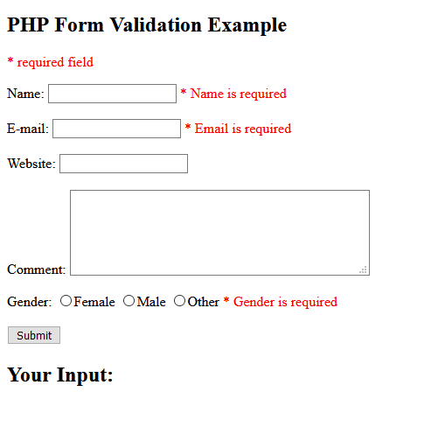
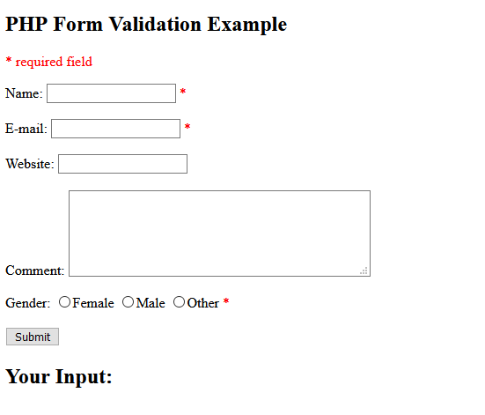
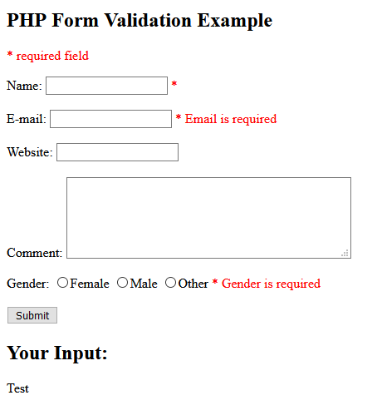

Slide 178
PHP Form Validation (continued)
Name validation:
$name = test_input($_POST["name"]);
if (!preg_match("/^[a-zA-Z-' ]*$/",$name)) {
$nameErr = "Only letters and white space allowed";
}
The preg_match() function searches a string for pattern, returning true if the pattern exists, and false otherwise.

Slide 179
PHP Form Validation (continued)
Email validation:
$email = test_input($_POST["email"]);
if (!filter_var($email, FILTER_VALIDATE_EMAIL)) {
$emailErr = "Invalid email format";
}

Slide 180
PHP Form Validation (continued)
$website = test_input($_POST["website"]);
if (!preg_match("/\b(?:(?:https?|ftp):\/\/|www\.)[-a-z0-9+&@#\/%?=~_|!:,.;]*[-a-z0-9+&@#\/%=~_|]/i",$website)) {
$websiteErr = "Invalid URL";
}

Slide 181
Using MySQL with PHP
For the database operations, either MySQLi or PDO might be used (the latter one is not going to be covered). MySQLi allows both procedural and OOP approach.

Slide 182
Using MySQL with PHP (continued)
To connect the database, these values are used (OOP):
<?php
$servername = "localhost";$username = "username";$password = "password";$dbname = "dbname";
// Create connection
$conn = new mysqli($servername, $username, $password, $dbname);
// Check connection
if ($conn->connect_error) {
die("Connection failed: " . $conn->connect_error);
}
?>

Slide 183
Using MySQL with PHP (continued)
To connect the database, these codes are used (procedural):
<?php
$servername = "localhost";$username = "username";$password = "password";$dbname = "dbname";
// Create connection
$conn = mysqli_connect($servername, $username, $password, $dbname);
// Check connection
if (!$conn) {die("Connection failed: " . mysqli_connect_error());}
?>

Slide 184
Using MySQL with PHP (continued)
To close the connection, these codes are used:
For OOP:
$conn→close();
For Procedural:
mysqli_close($conn);

Slide 185
Using MySQL with PHP (continued)
To execute the specific SQL statements, these codes are used:
For OOP:
$conn->query($sql)
For Procedural:
mysqli_query($conn, $sql);
Remember that if you create a database, you shouldn’t specify it while connecting (in other words, only the server name, the user name, and the password should be specified)

Slide 186
Using MySQL with PHP (continued)
A prepared statement is a feature used to execute the same (or similar) SQL statements repeatedly with high efficiency. It is done by $conn→prepare($sql); usually executed by $stmt = $conn→prepare($sql);
Prepared statements basically work like this:
Prepare: An SQL statement template is created and sent to the database. Certain values are left unspecified, called parameters (labeled "?"). Example: INSERT INTO MyGuests VALUES(?, ?, ?)
The database parses, compiles, and performs query optimization on the SQL statement template, and stores the result without executing it
Execute: At a later time, the application binds the values to the parameters, and the database executes the statement. The application may execute the statement as many times as it wants with different values
Compared to executing SQL statements directly, prepared statements have three main advantages:
Prepared statements reduce parsing time as the preparation on the query is done only once (although the statement is executed multiple times)
Bound parameters minimize bandwidth to the server as you need send only the parameters each time, and not the whole query. It is done by $stmt->bind_param("arguments", variables); arguments are i – integer, d – double, s – string, b – BLOB and written in quotes. Be sure that arguments are equal to the number of variables.
Prepared statements are very useful against SQL injections, because parameter values, which are transmitted later using a different protocol, need not be correctly escaped. If the original statement template is not derived from external input, SQL injection cannot occur.

Slide 187
Using MySQL with PHP (continued)
<!DOCTYPE HTML>
<html>
<head>
<style>
.error {color: #FF0000;}
</style>
</head>
<body>

Slide 188
Using MySQL with PHP (continued) (the continue of the code)
<?php
$servername = "localhost";
$username = "root";
$password = "root";
$dbname = "myDB";
// Create connection
$conn = new mysqli($servername, $username, $password, $dbname);
// Check connection
if ($conn->connect_error) {
die("Connection failed: " . $conn->connect_error);
}
?>

Slide 189
Using MySQL with PHP (continued) (the continue of the code)
<?php
// define variables and set to empty values
$nameErr = $emailErr = $genderErr = $websiteErr = "";
$name = $email = $gender = $comment = $website = "";
if ($_SERVER["REQUEST_METHOD"] == "POST") {
if (empty($_POST["name"])) {
$nameErr = "Name is required";
} else {
$name = test_input($_POST["name"]);
}
if (empty($_POST["email"])) {
$emailErr = "Email is required";
} else {
$email = test_input($_POST["email"]);
}

Slide 190
Using MySQL with PHP (continued) (the continue of the code)
if (empty($_POST["website"])) {$website = "";} else {$website = test_input($_POST["website"]);}
if (empty($_POST["comment"])) {$comment = "";} else {$comment = test_input($_POST["comment"]);}
if (empty($_POST["gender"])) {$genderErr = "Gender is required";} else {$gender = test_input($_POST["gender"]);}
}

Slide 191
Using MySQL with PHP (continued) (the continue of the code)
function test_input($data) {
$data = trim($data);
$data = stripslashes($data);
$data = htmlspecialchars($data);
return $data;
}
?>

Slide 192
Using MySQL with PHP (continued) (the continue of the code)
<h2>PHP Form Validation Example</h2><p><span class="error">* required field</span></p><form method="post" action="<?php echo htmlspecialchars($_SERVER["PHP_SELF"]);?>">Name: <input type="text" name="name"><span class="error">* <?php echo $nameErr;?></span><br><br>E-mail: <input type="text" name="email"><span class="error">* <?php echo $emailErr;?></span><br><br>Website: <input type="text" name="website"><span class="error"><?php echo $websiteErr;?></span><br><br>Comment: <textarea name="comment" rows="5" cols="40"></textarea><br><br>Gender:<input type="radio" name="gender" value="female">Female<input type="radio" name="gender" value="male">Male<input type="radio" name="gender" value="other">Other<span class="error">* <?php echo $genderErr;?></span><br><br><input type="submit" name="submit" value="Submit"></form>

Slide 193
Using MySQL with PHP (continued) (the continue of the code)
<?php
if(isset($_POST["submit"]))
{
$sql = "INSERT INTO myguests (name, email, gender, comment, website) VALUES (?, ?, ?, ?, ?)";
$stmt = $conn->prepare($sql);
$stmt->bind_param("sssss", $name, $email, $gender, $comment, $website);
$stmt->execute();
$stmt->close();
echo "Data entered successfully!";
}
?>
</body>
</html>

Slide 194
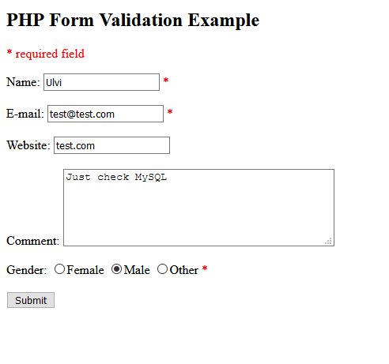
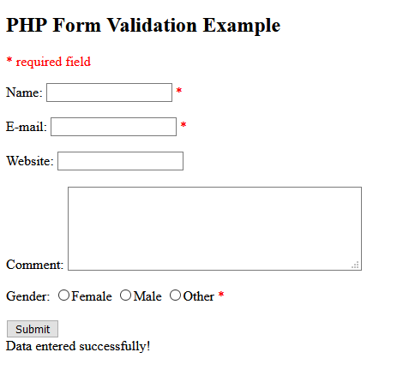

Slide 195
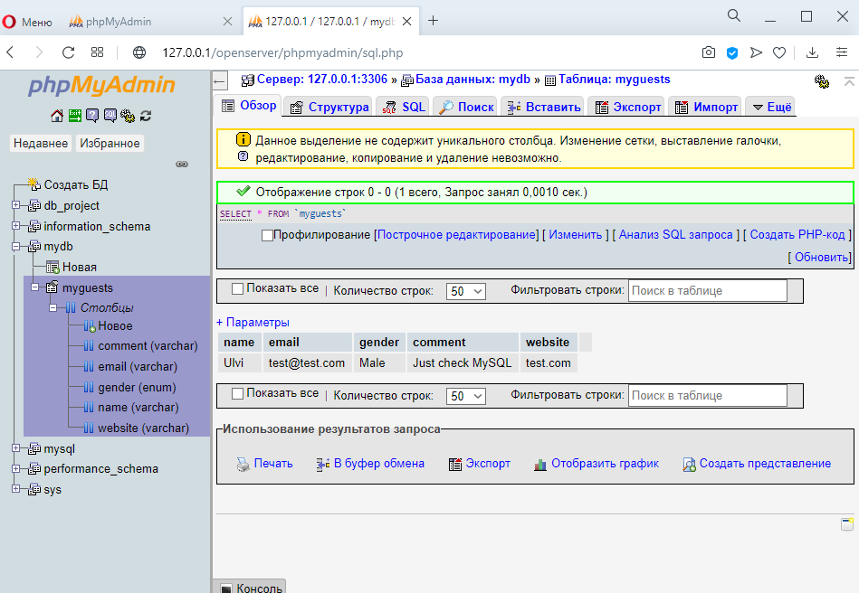

Slide 196
PHP Mails
Is sent by mail() function;
Has limited functionality;
PHP mail function does not support SMTP authentication and doesn’t allow sending messages via external servers.
The syntax is (headers and parameters are optional):
<?php
mail($to_email_address,$subject,$message,[$headers],[$parameters]);
?>

Slide 197
PHP Mails (continued)
if(isset($_POST["submit"]))
{
mail($email, "Test", $comment);
echo "mail sent successfully!";
}
?>

Slide 198
